Slide 1


Dematerialization of Shares: A Comprehensive Guide
Dematerialization is the process of converting physical share certificates into electronic form. This process is crucial for modern-day stock trading, simplifying transactions and enhancing efficiency.
AM
by Anoop Mohanty

Slide 2

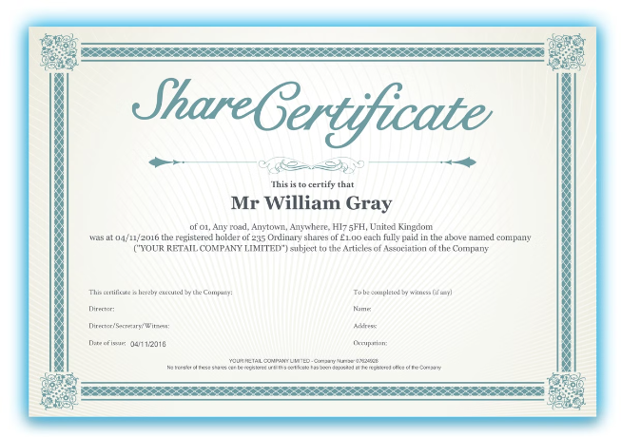
Client's Request for Dematerialization
1
Initiation
2
Account Details
A client initiates the dematerialization process by contacting their Depository Participant (DP) and submitting a request.
The client needs to provide their Demat account details, including the account number, name, and address, to the DP.
3
Share Details
4
Request Form
The client also needs to provide information about the shares they wish to dematerialize, including the company name, number of shares, and certificate numbers.
The client needs to fill out a Demat request form, which includes details of the shares and the client's Demat account.

Slide 3
Role of the Depository Participant
Depository Participant (DP)
Key Functions
Account Management
A DP acts as an intermediary between the client and the Depository, handling all aspects of the dematerialization process.
The DP verifies the client's request, coordinates with the issuer company, and credits the dematerialized shares to the client's Demat account.
The DP manages the client's Demat account, including opening, closing, and maintaining it.

Slide 4


Verification of Client's Demat Account
Account Authentication
Identity Verification
Account Validity
The DP verifies the client's Demat account details by cross-referencing them with the Depository's database.
The DP may require the client to provide additional documentation to verify their identity, such as a passport or driver's license.
The DP ensures that the client's Demat account is active and in good standing before proceeding with the dematerialization process.

Slide 5


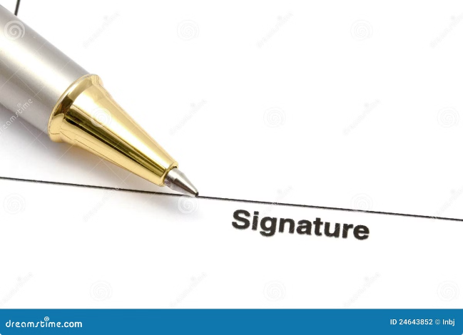


Submission of Demat Request Form
Form Completion
The client fills out the Demat request form, providing all necessary information about the shares and their Demat account.
Form Submission
The client submits the completed form to the DP along with the original share certificates.
Form Review
The DP reviews the form to ensure accuracy and completeness of the details provided by the client.

Slide 6

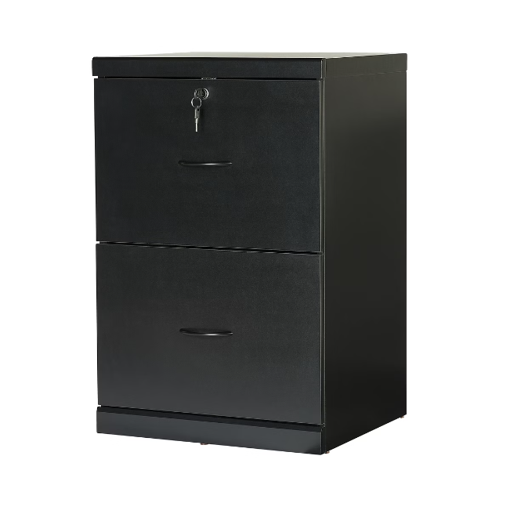
Blocking of Physical Shares
1
Issuing Company Contact
The DP contacts the issuer company, informing them about the client's dematerialization request.
2
Share Blocking
The issuer company blocks the physical share certificates to prevent further transactions while the dematerialization process is underway.
3
Certificate Verification
The issuer company verifies the authenticity of the physical share certificates submitted by the client.

Slide 7






Intimation to the Issuer Company
Communication
Share Details
The DP informs the issuer company about the client's request for dematerialization.
The DP provides the issuer company with the details of the shares, including the certificate numbers and the number of shares.
Timeline
Confirmation
The DP communicates the expected timeframe for the completion of the dematerialization process.
The DP confirms with the issuer company that they have received the request and will proceed with the dematerialization process.

Slide 8


Conversion of Physical Shares to Dematerialized Shares
The issuer company updates its records to reflect the dematerialization of the shares.
The issuer company generates electronic share certificates representing the dematerialized shares.
The issuer company transmits the electronic share certificates to the Depository through a secure network.

Slide 9
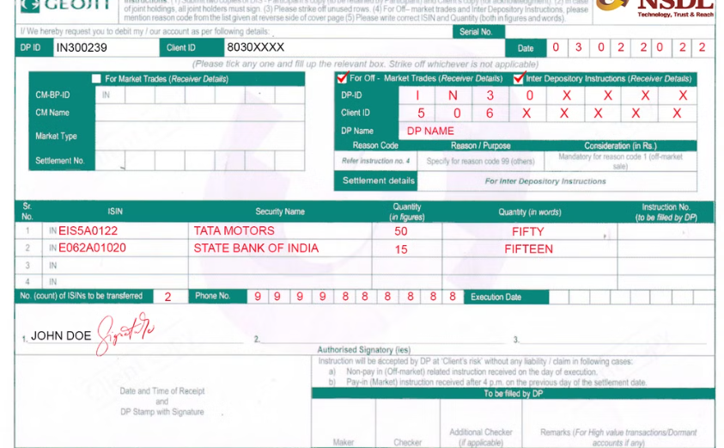

Crediting of Dematerialized Shares to Client's Account
Account Update
Confirmation
The Depository updates the client's Demat account with the newly dematerialized shares.
The client receives confirmation from the DP that their shares have been successfully dematerialized and credited to their Demat account.

Slide 10


Conclusion and Benefits of Dematerialization
1
Enhanced Security
2
Ease of Trading
Dematerialized shares are held electronically, making them more secure than physical certificates.
Dematerialized shares can be traded more easily and quickly than physical certificates.
3
Reduced Costs
4
Improved Efficiency
Dematerialization reduces the costs associated with handling and storing physical certificates.
Dematerialization streamlines the trading process and makes it more efficient.

